Slide 1


Craig Kent
09/29/2023

Slide 2

Outline
Executive Summary
Introduction
Methodology
Results
Conclusion
Appendix

Slide 3
Executive Summary
Summary of methodologies
Data Collection Using SpaceX API
Data Collection through Web Scraping
Data Wrangling
Exploratory Data Analysis using SQL
EDA DataViz using Python Pandas and Matplotlib
Launch Sites Analysis with Folium Interactive Visual Analytics and Ploty Dash
Machine Learning Landing Prediction
Summary of all results
EDA
Interactive Visual Analytics and Dashboards
Predictive Analysis

Slide 4
Introduction
Project background and context
SpaceX advertises Falcon 9 rocket launches on its website, with a cost of 62 million dollars; other providers cost upward of 165 million dollars each, much of the savings is because SpaceX can reuse the first stage. Therefore if we can determine if the first stage will land, we can determine the cost of a launch. This information can be used if an alternate company wants to bid against SpaceX for a rocket launch.
Problems you want to find answers
In this capstone, we will predict if the Falcon 9 first stage will land successfully. SpaceX advertises Falcon 9 rocket launches on its website, with a cost of 62 million dollars; other providers cost upward of 165 million dollars each, much of the savings is because SpaceX can reuse the first stage. Therefore if we can determine if the first stage will land, we can determine the cost of a launch. This information can be used if an alternate company wants to bid against SpaceX for a rocket launch.

Slide 5

Section 1

Slide 6
Methodology
Executive Summary
Data collection methodology:
Describes how data sets were collected
Perform data wrangling
Describes how data were processed
Perform exploratory data analysis (EDA) using visualization and SQL
Perform interactive visual analytics using Folium and Plotly Dash
Perform predictive analysis using classification models
How to build, tune, evaluate classification models

Slide 7
Data Collection
SpaceX Data Request Flowchart
Import Libraries and Define Auxiliary Functions Requests allows to make HTTP requests which can be used to get data from an API
Request and parse the SpaceX launch data using the GET request
Start Data Collection
Use json_normalize meethod to convert the json result into a dataframe
End Data Collection
Requests to SpaceX allows to make HTTP requests which are used to get data from an API

Slide 8
Data Collection – SpaceX API
Start of API Calls
The flowchart to the right shows using SpaceX’s RESTful API and a get request to parse the data. The from a Json dataset converting the data into a Pandas data frame.
GitHub URL of the completed SpaceX API calls notebook: https://github.com/ckent123/Data-Science/blob/main/jupyter-labs-spacex-data-collection-api.ipynb
Rocket Booster Data API
Launch Site Data API
Payload Data API
Core Data API
Use json to normalize and convert into dataframe
End of API Calls

Slide 9
Data Collection - Scraping
Start of Web Scraping
To the right is a flowchart showing Web Scraping to get data on launch records from Wikipedia
GitHub URL of the completed web scraping notebook: https://github.com/ckent123/Data-Science/blob/main/jupyter-labs-webscraping.ipynb
Installed BeautifulSoup in Python & used helper functions to process webscraping
Used HTTP Get method for data request and created BeautifulSoup object
Extracted all column/variable names from the HTML table header
Create a data frame by parsing the launch HTML tables
End of Web Scraping

Slide 10
Data Wrangling
Dealt with missing values in the LandingPad column by having none values represent when landing pads were not used. Calculated the mean for the PayloadMass using the mean() function. Used the mean and the replace() function to replace non-numeric values in the data with the mean that was calculated.
GitHub URL of completed data wrangling related notebooks: https://github.com/ckent123/Data-Science/blob/main/jupyter-labs-spacex-data-collection-api.ipynb
Start of Data Wrangling
Calculate the mean value of PayloadMass column
Replace the non-numeric values with its mean value
End of Data Wrangling

Slide 11
EDA with Data Visualization
Charts Used:
FlightNumber vs. PayloadMass – To show if payload affected the success of the launches as more launches occurred over time.
FlightNumber vs LaunchSite – To show if location was a factor in the success of each launch.
Payload Vs. Launch Site – To show if the combination of location and payload had an affect on the success of the launch.
Payload vs. Orbit – To show if achieving a certain orbit was affected by payload.
GitHub URL of completed EDA with data visualization notebook: https://github.com/ckent123/Data-Science/blob/main/jupyter-labs-eda-dataviz.ipynb.jupyterlite.ipynb

Slide 12
EDA with SQL
SQL queries performed:
Displayed the names of the unique launch sites in the space mission using Distinct statement.
Displayed 5 records where launch sites begin with the string 'CCA’ using limit clause.
Displayed the total payload mass carried by boosters launched by NASA (CRS) using sum function and group by clause.
Displayed average payload mass carried by booster version F9 v1.1 average function.
Listed the date when the first successful landing outcome in ground pad was achieved by using min function.
Listed the names of the boosters which have success in drone ship and have payload mass greater than 4000 but less than 6000
Listed the total number of successful and failure mission outcomes by using trim and count functions and group by clause.
Listed the names of the booster_versions which have carried the maximum payload mass using a sub query.
Listed the records which will display the month names, failure landing_outcomes in drone ship ,booster versions, launch_site for the months in year 2015.
Rank the count of landing outcomes (such as Failure (drone ship) or Success (ground pad)) between the date 2010-06-04 and 2017-03-20, in descending order.
GitHub URL of completed EDA with SQL notebook: https://github.com/ckent123/Data-Science/blob/main/jupyter-labs-eda-sql-coursera_sqllite.ipynb

Slide 13
Build an Interactive Map with Folium
Folium Map Objects:
Circle – to highlight specific coordinates
Marker – to show successful(green) and failed(red) launches by color
Mouse Position – to explore the maps for coordinate information
PolyLine – to show distances between points
GitHub URL of completed interactive map with Folium map: https://github.com/ckent123/Data-Science/blob/main/lab_jupyter_launch_site_location.jupyterlite.ipynb

Slide 14
Build a Dashboard with Plotly Dash
Summarize what plots/graphs and interactions you have added to a dashboard
Explain why you added those plots and interactions
Add the GitHub URL of your completed Plotly Dash lab, as an external reference and peer-review purpose

Slide 15
Predictive Analysis (Classification)
Summarize how you built, evaluated, improved, and found the best performing classification model
You need present your model development process using key phrases and flowchart
Add the GitHub URL of your completed predictive analysis lab, as an external reference and peer-review purpose

Slide 16
Results
Exploratory data analysis results
Interactive analytics demo in screenshots
Predictive analysis results

Slide 17

Section 2

Slide 18
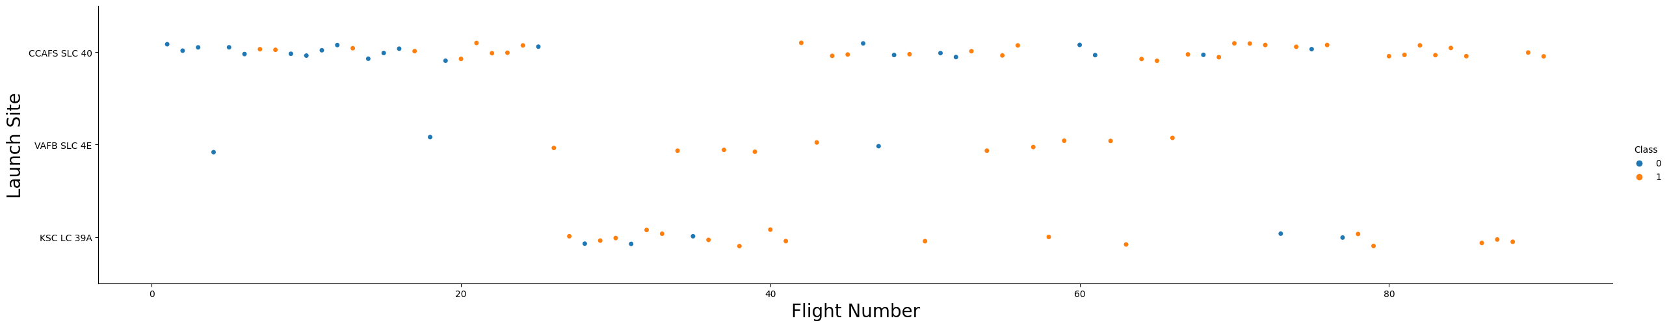
Flight Number vs. Launch Site
Number vs. Launch Site
Scatter plot with explanations
With each flight that is completed no matter what site had the launch, the success of each flight goes up.

Slide 19
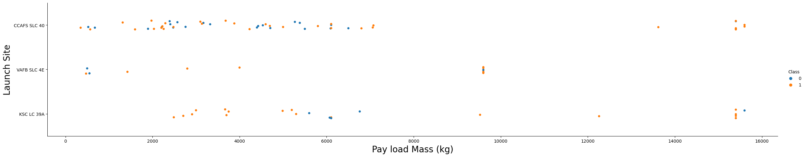
Payload vs. Launch Site
Payload vs. Launch Site
Scatter plot with explanations
If you observe Payload Vs. Launch Site scatter point chart you will find for the VAFB-SLC launch site there are no rockets launched for heavy payload mass(greater than 10000).

Slide 20
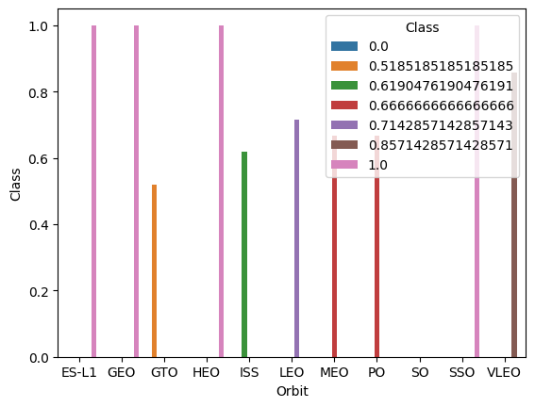
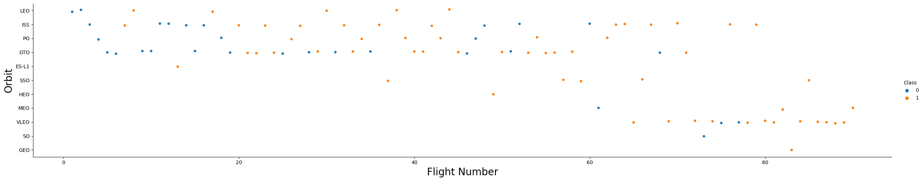
Success Rate vs. Orbit Type
Success rate of each orbit type
Scatter plot with explanations
You should see that in the LEO orbit the Success appears related to the number of flights; on the other hand, there seems to be no relationship between flight number when in GTO orbit.

Slide 21
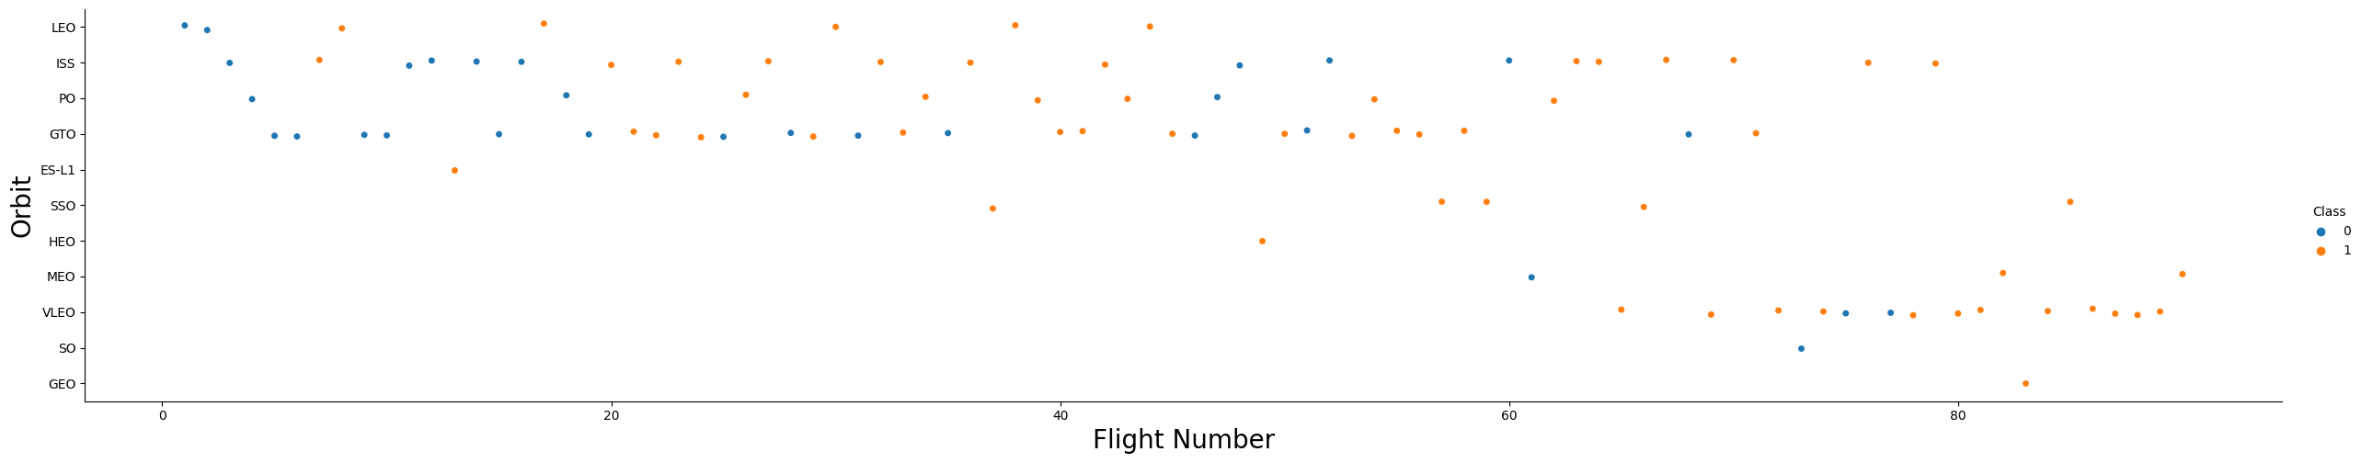
Flight Number vs. Orbit Type
Scatter point of Flight number vs. Orbit type
Scatter plot with explanations
You should see that in the LEO orbit the Success appears related to the number of flights; on the other hand, there seems to be no relationship between flight number when in GTO orbit.

Slide 22
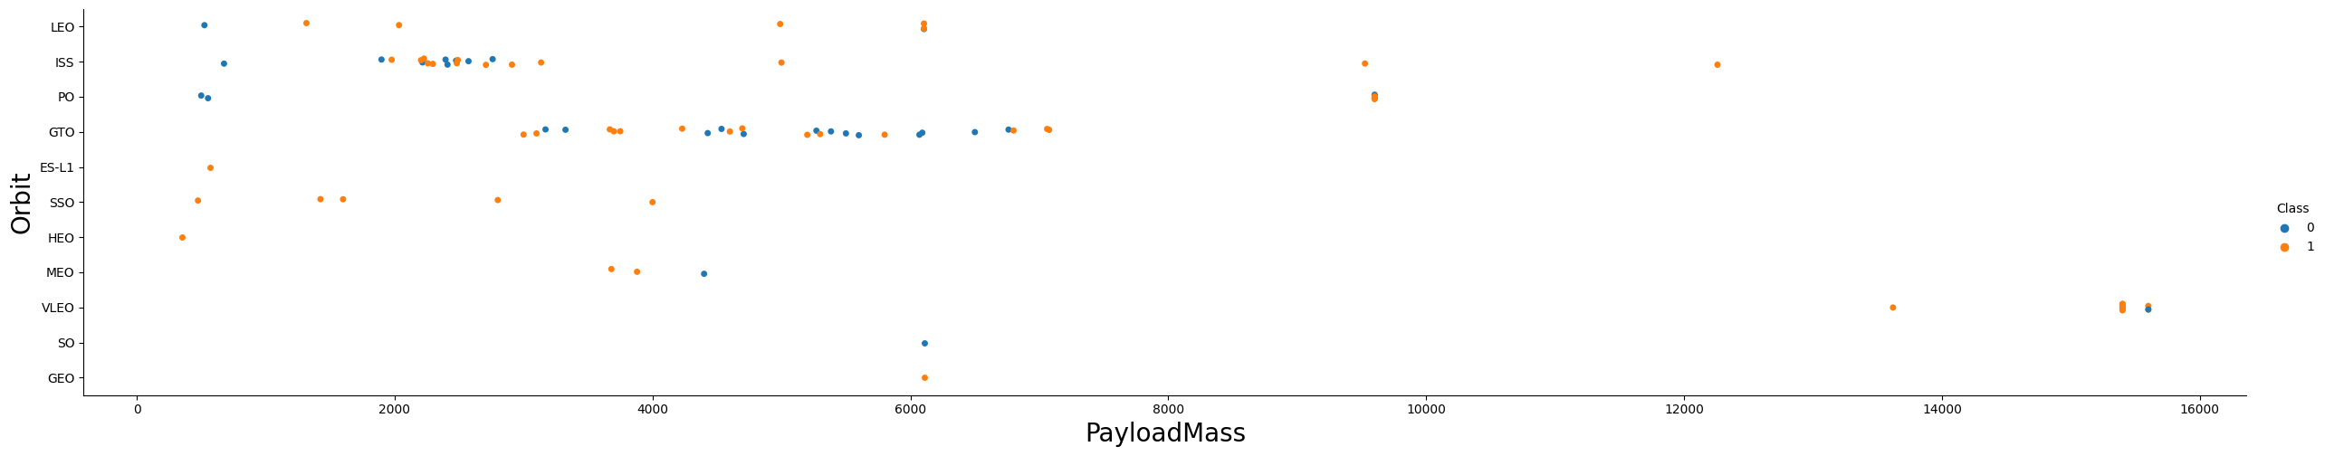
Payload vs. Orbit Type
Scatter point of payload vs. orbit type
Scatter plot with explanations
The successful landings are showing in the orbits of ISS, LEO and Polar. And the data shows there isn’t a statistical difference with the GTO orbit. There isn’t a lot of data on the other orbits.

Slide 23
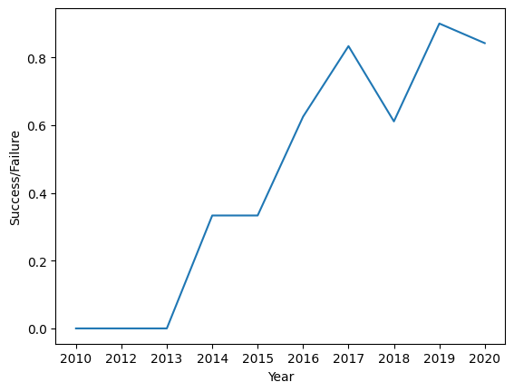
Launch Success Yearly Trend
Line chart of yearly average success rate
The line chart shows an increasing success rate starting in 2013 through 2020.

Slide 24
All Launch Site Names
Launch_Site
CCAFS LC-40
VAFB SLC-4E
KSC LC-39A
CCAFS SLC-40
Find the names of the unique launch sites
The query uses a distinct statement on the Launch_site field to show only the unique data for each site.
%sql select distinct Launch_Site from spacextable

Slide 25
Launch Site Names Begin with 'CCA'
Date | Time (UTC) | Booster_Version | Launch_Site | Payload | PAYLOAD_MASS__KG_ | Orbit | Customer | Mission_Outcome | Landing_Outcome
2010-04-06 | 18:45:00 | F9 v1.0 B0003 | CCAFS LC-40 | Dragon Spacecraft Qualification Unit | 0 | LEO | SpaceX | Success | Failure (parachute)
2010-08-12 | 15:43:00 | F9 v1.0 B0004 | CCAFS LC-40 | Dragon demo flight C1, two CubeSats, barrel of Brouere cheese | 0 | LEO (ISS) | NASA (COTS) NRO | Success | Failure (parachute)
2012-05-22 | 07:44:00 | F9 v1.0 B0005 | CCAFS LC-40 | Dragon demo flight C2 | 525 | LEO (ISS) | NASA (COTS) | Success | No attempt
2012-08-10 | 00:35:00 | F9 v1.0 B0006 | CCAFS LC-40 | SpaceX CRS-1 | 500 | LEO (ISS) | NASA (CRS) | Success | No attempt
2013-01-03 | 15:10:00 | F9 v1.0 B0007 | CCAFS LC-40 | SpaceX CRS-2 | 677 | LEO (ISS) | NASA (CRS) | Success | No attempt
Find 5 records where launch sites begin with `CCA`
Used select * to show all fields in record. And used the “like” wildcard operator to show only records that begin with “CCA”.
%sql select * from spacextable where Launch_Site like 'CCA%' limit 5

Slide 26
Total Payload Mass
Calculate the total payload carried by boosters from NASA
%sql select customer, sum(PAYLOAD_MASS__KG_) as total_payload from spacextable where customer = 'NASA (CRS)' group by 1
Present your query result with a short explanation here
Customer | total_payload
NASA (CRS) | 45596
Filtered for only NASA boosters then used the sum function on the “Payload_Mass__KG_” field to get total payload. It wasn’t needed but there is a group by on the “customer” field. This could help for totaling more than one customer.

Slide 27
Average Payload Mass by F9 v1.1
Calculate the average payload mass carried by booster version F9 v1.1
%sql select Booster_Version, avg(PAYLOAD_MASS__KG_) as average_payload from spacextable where Booster_Version = 'F9 v1.1' group by 1
Present your query result with a short explanation here
Booster_Version | average_payload
F9 v1.1 | 2928.4
Filtered for only 'F9 v1.1' boosters then used the “avg” function on the “Payload_Mass__KG_” field to get total payload. It wasn’t needed but there is a group by on the “Booster_Version” field. This could help for totaling more than one Booster.

Slide 28
First Successful Ground Landing Date
Find the dates of the first successful landing outcome on ground pad
Present your query result with a short explanation here
%sql select min(date) as date from spacextable where landing_outcome = 'Success (ground pad)'
date
2015-12-22
Filtered for only 'Success (ground pad)’ from landing_outcome then used the “min” function on the “date” field to get the first date.

Slide 29
Successful Drone Ship Landing with Payload between 4000 and 6000
List the names of boosters which have successfully landed on drone ship and had payload mass greater than 4000 but less than 6000
Booster_Version
F9 FT B1022
F9 FT B1026
F9 FT B1021.2
F9 FT B1031.2
Present your query result with a short explanation here
%sql select booster_version from spacextable where landing_outcome = 'Success (drone ship)' and PAYLOAD_MASS__KG_ between 4000 and 6000
Filtered for 'Success (drone ship)' from landing_outcome and used the between clause for “PAYLOAD_MASS__KG_ ”.

Slide 30
Total Number of Successful and Failure Mission Outcomes
Calculate the total number of successful and failure mission outcomes
%sql select trim(mission_outcome) as mission_outcome, count(mission_outcome) as outcome_count from spacextable group by 1
Present your query result with a short explanation here
mission_outcome | outcome_count
Failure (in flight) | 1
Success | 99
Success (payload status unclear) | 1
Used the trim function to help with grouping. Aliased “mission_outcome” field for presentation purpose.

Slide 31
Boosters Carried Maximum Payload
Booster_Version
F9 B5 B1048.4
F9 B5 B1048.5
F9 B5 B1049.4
F9 B5 B1049.5
F9 B5 B1049.7
F9 B5 B1051.3
F9 B5 B1051.4
F9 B5 B1051.6
F9 B5 B1056.4
F9 B5 B1058.3
F9 B5 B1060.2
F9 B5 B1060.3
List the names of the booster which have carried the maximum payload mass
Present your query result with a short explanation here
Used a sub query to capture maximum payload. Then joined that sub query to the “spacxtable” table to use as criteria for max payload for each booster version
%sql select a.booster_version\
from spacextable a,\
(select max(PAYLOAD_MASS__KG_) as max_payload\
from spacextable) b\
where a.PAYLOAD_MASS__KG_ = b.max_payload\
order by 1

Slide 32
2015 Launch Records
List the failed landing_outcomes in drone ship, their booster versions, and launch site names for in year 2015
Present your query result with a short explanation here
month | Landing_Outcome | Booster_Version | Launch_Site
10 | Failure (drone ship) | F9 v1.1 B1012 | CCAFS LC-40
04 | Failure (drone ship) | F9 v1.1 B1015 | CCAFS LC-40
Used the “substr” function to get the month number. Used the between operator for the date range. Used the “like” wildcard for landing outcomes
%sql select substr(date,6,2) as month,\
Landing_Outcome,\
Booster_Version,\
Launch_Site\
from spacextable\
where date between '2015-01-01' and '2015-12-31'\
and Landing_Outcome like '%drone ship%'\
and Landing_Outcome like '%Failure%'

Slide 33
Rank Landing Outcomes Between 2010-06-04 and 2017-03-20
Rank the count of landing outcomes (such as Failure (drone ship) or Success (ground pad)) between the date 2010-06-04 and 2017-03-20, in descending order
Used trim function to help with grouping. Used the count statement for landing outcome. Used the between function for date range. Used the order clause for descending order.
landing_outcome | outcome_counts
No attempt | 10
Success (ground pad) | 5
Success (drone ship) | 5
Failure (drone ship) | 5
Controlled (ocean) | 3
Uncontrolled (ocean) | 2
Precluded (drone ship) | 1
Failure (parachute) | 1
%sql select trim(a.landing_outcome) as landing_outcome,\
count(a.landing_outcome) outcome_counts\
from spacextable a\
where date between '2010-06-04' and '2017-03-20'\
group by 1\
order by 2 desc

Slide 34

Section 3

Slide 35
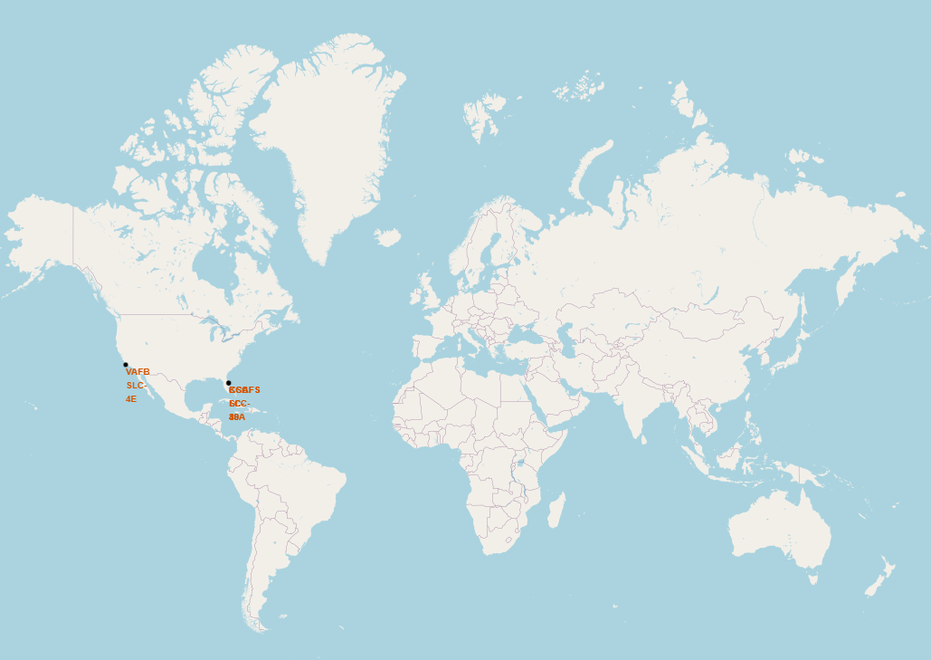
SpaceX Launch Sites
Launch Sites are all in the US. There are three, two in Florida and one in California. All are on the coast.

Slide 36
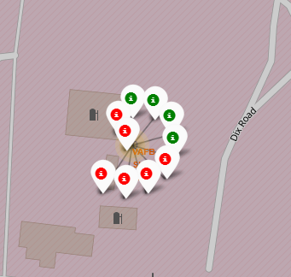
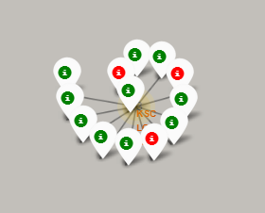
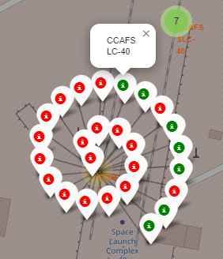
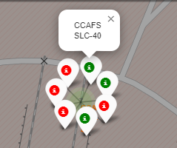
Maps of Launch Sites Showing Results
VAFB
California
KSC
Florida
CCAFS LC & SLC
Florida
Green = Success
Red = Failed
KSC site shows the most successes. But the flight numbers should also be considered.

Slide 37
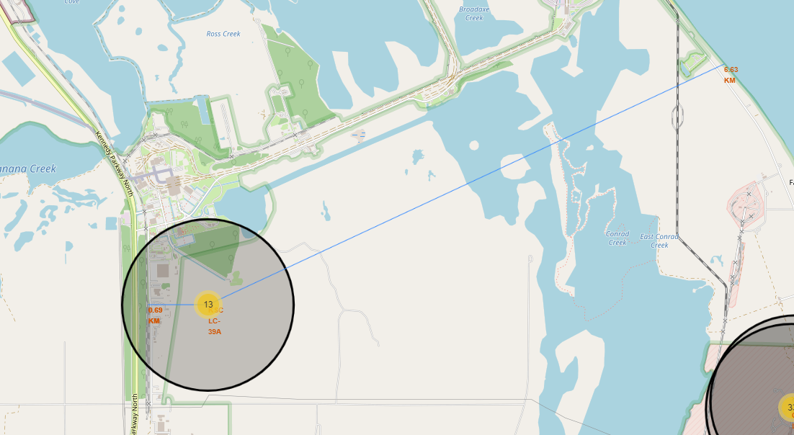
Most Successful Launch Site: KSC LC-39-A
KSC LC-39-A is approximately 6.63km from the coast. And approximately 0.69km from the train tracks.
It seems that this launch site may be easily accessible, but yet relatively close to the coastline.

Slide 38

Section 4

Slide 39
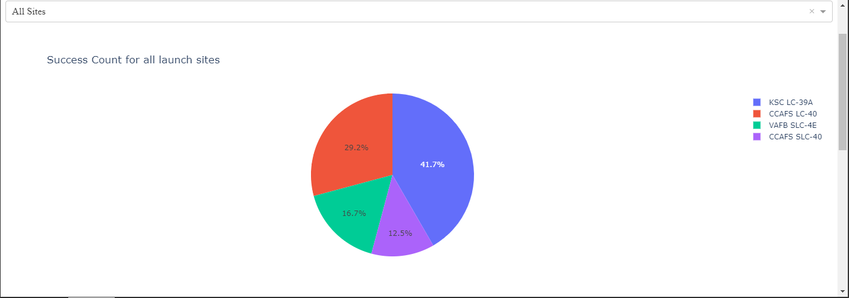
Launch Site Successes
The KSC LC-39A has the most success out of all the lunch sites as shown in the pie chart above. Although the flight number should be considered as well.

Slide 40
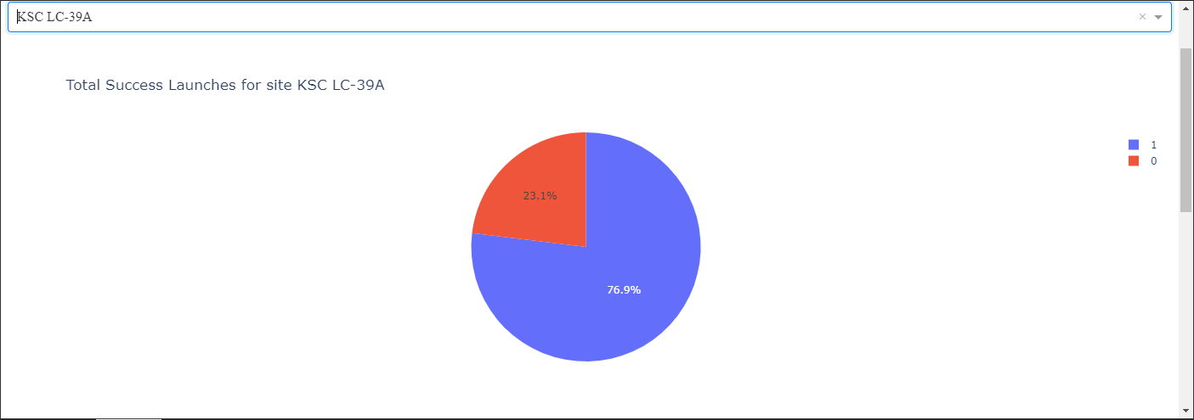
Most Successful Launch Site Chart
It shows that just over ¾ of the time lunches are successful at this site.

Slide 41
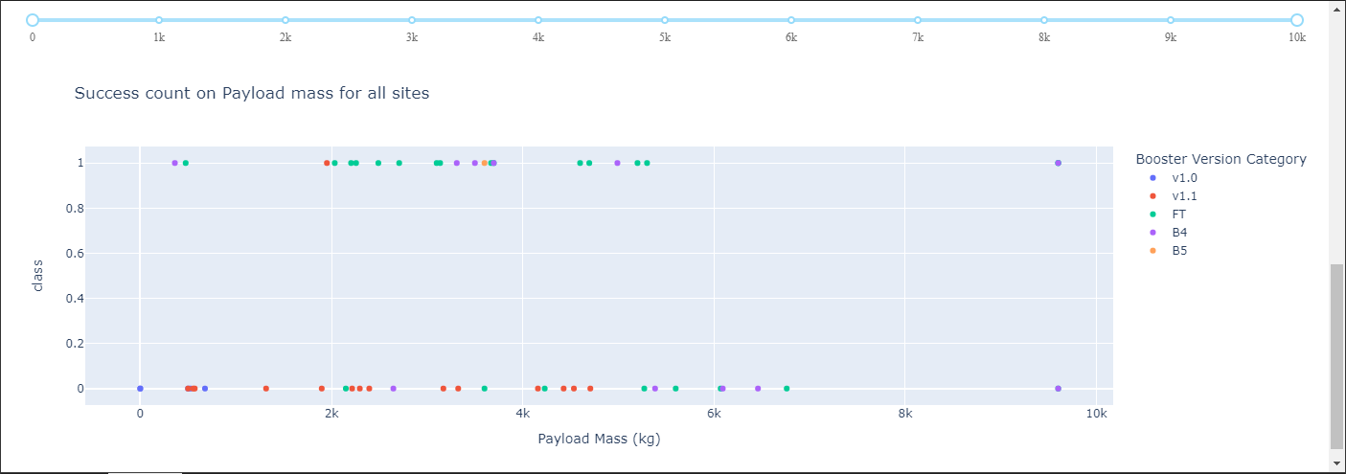
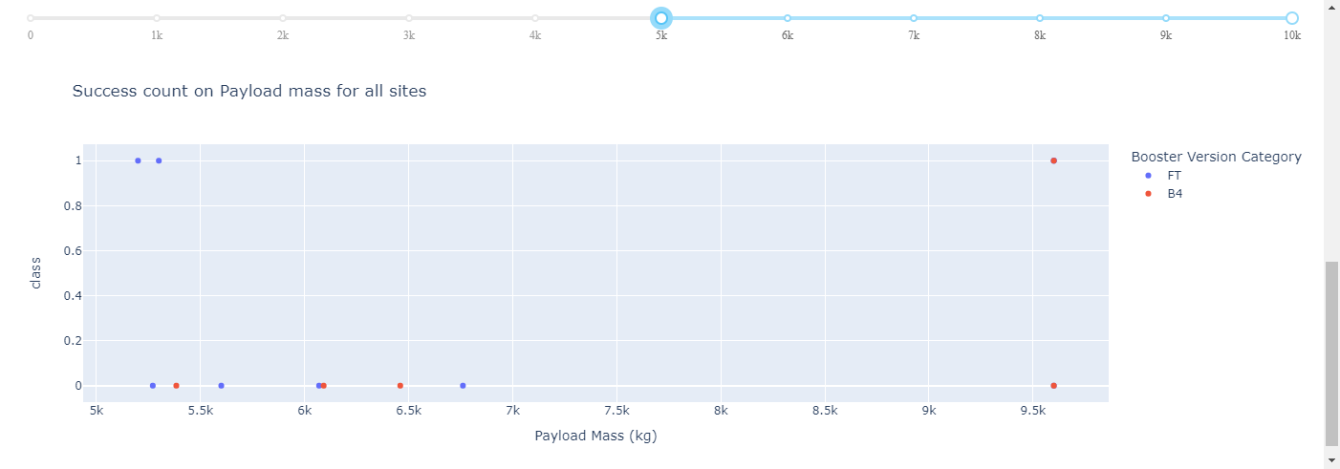
Payload vs. Launch Outcome
The first plot graph shows that most of the successful lunches were with the FT booster. The second graph shows that when the payload is over 5000Kg that the FT and B4 boosters where the only ones that could lift the payload and that the success ratio dropped.

Slide 42

Section 5

Slide 43
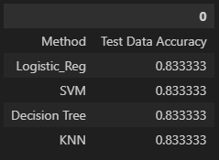
Classification Accuracy
As shown in the table above, all methods / Classification performed equally.

Slide 44

Confusion Matrix
There was false positives but the confusion matrix is the same for all four classifications.

Slide 45
Conclusions
The most overall conclusion that can be made is the most obvious one. The success rate of the launches and landings have increased from 2013 through 2020.
The lighter the payload the more successful the launches.
The launches that strived for certain orbits were more successful. (SSO, ES-L1, GEO & HEO)
All the predictive models seemed to have the same degree of accuracy.

Slide 46
Appendix
GitHub link:

Slide 47


